Slide 1
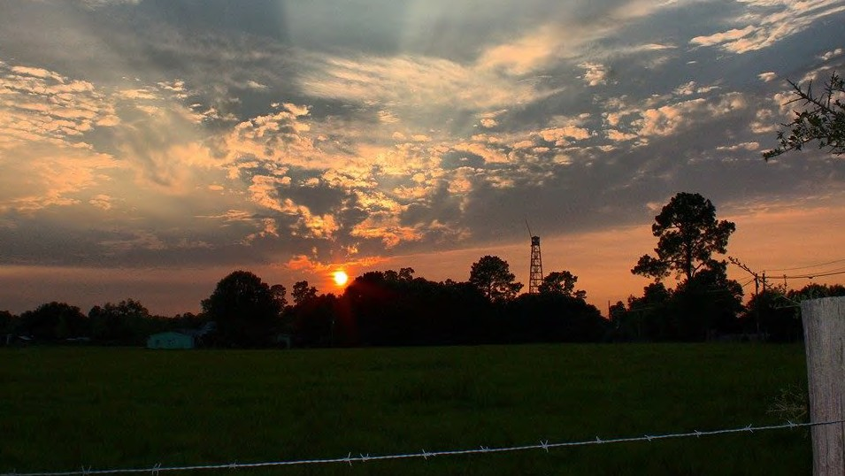


Kick-Off Presentation to Board of County Commissioners
May 14, 2020
+
IMPACT CAMPAIGNS | WEITZMAN | URBAN 3 | NELSON / NYGAARD | GIT CONSULTING | SPECK & ASSOCIATES

Slide 2
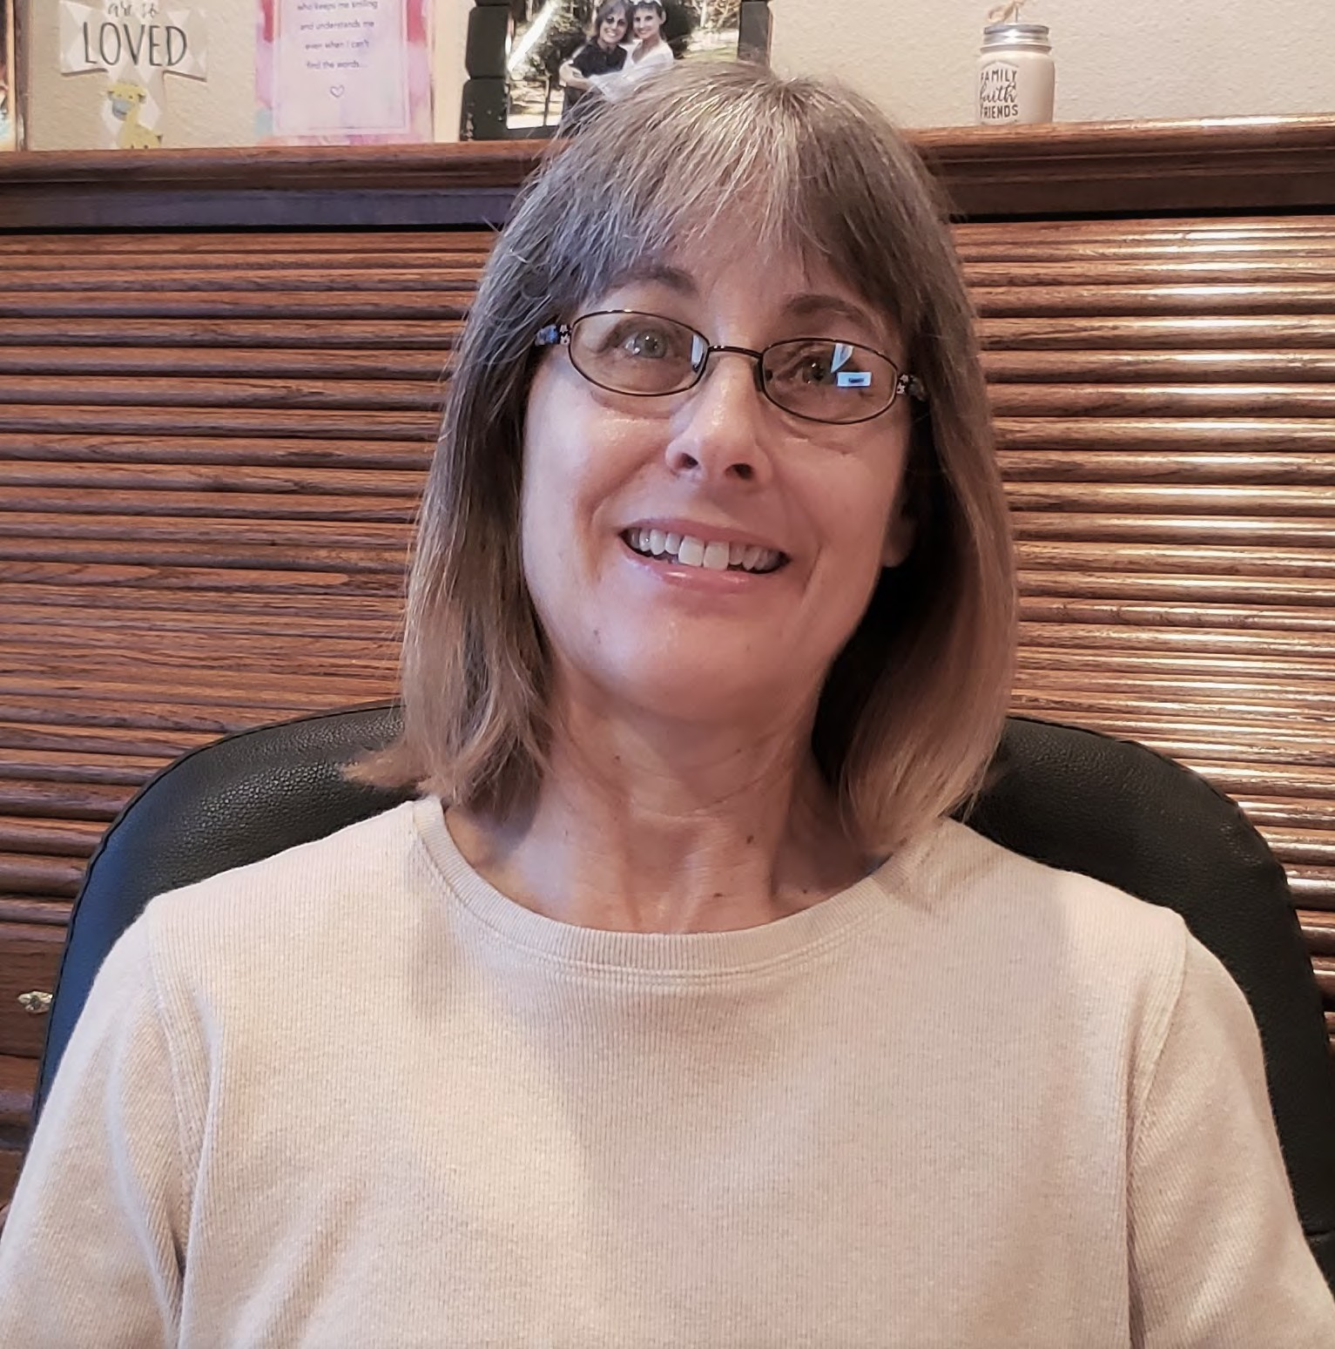
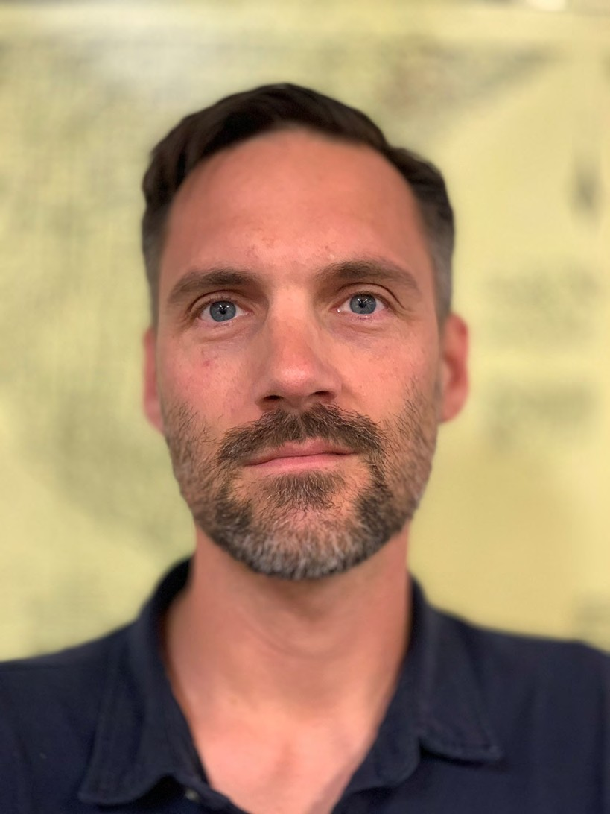
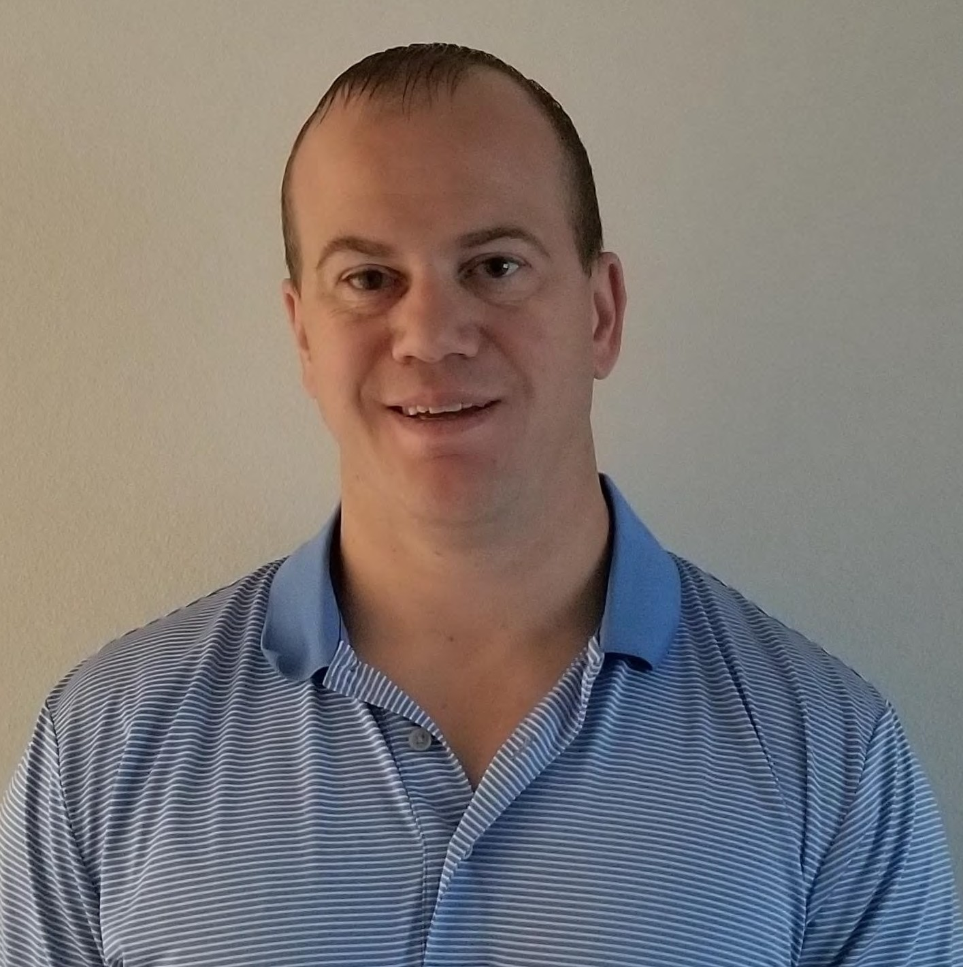
Terri
Brent
John
Project Coordinator
Natural Resources Management Department
Division Manager
Natural Resources Management Department
Senior Planner
Development Services Department
County Team

Slide 3
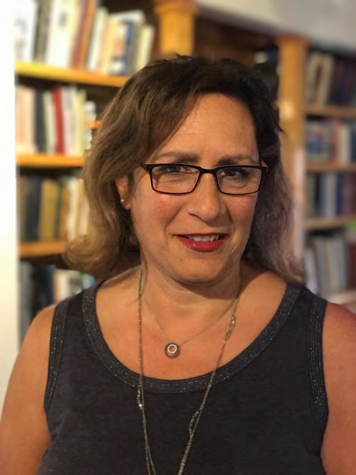
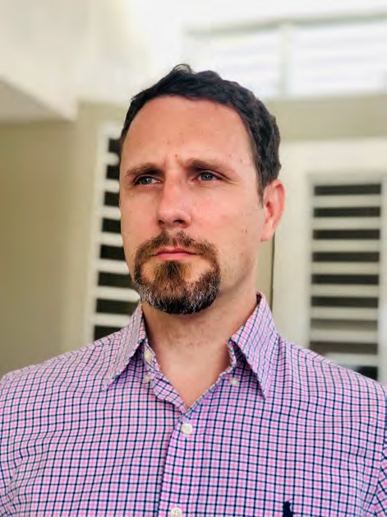


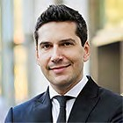
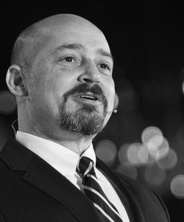

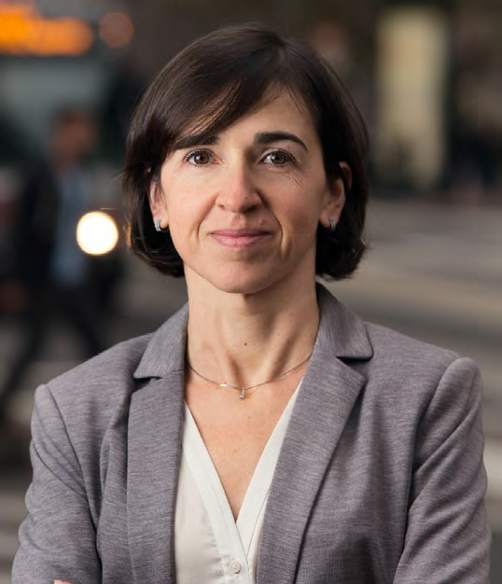
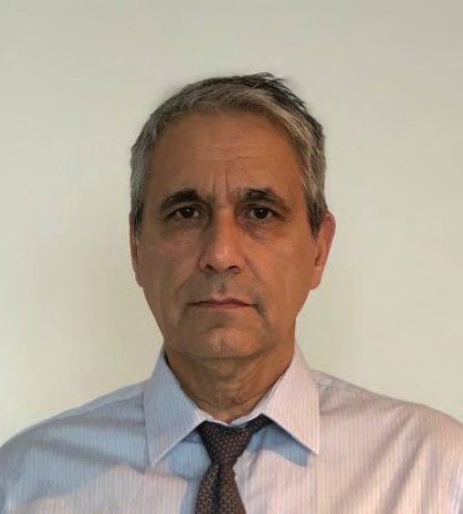

Marina
Mike
DPZ CoDesign
Travis
Brooke
Impact Campaign
Stakeholder Engagement
Project Management, Master Planning & Urban Design
Peter
Weitzman Associates
Residential & Commercial Market Studies
Joe
Cate
Urban 3
Economic Impact Analysis
Meritxell
Nelson\Nygaard Consulting
Transportation Analysis & Planning
Georgio
GIT Consulting
Environmental Infrastructure Analysis & Civil Engineering
Jeff
Speck & Associates
Walkability Advisor
DPZ Team

Slide 4
Phase 1 ASSESSMENT & ANALYSES Conduct kick-off Gather and Assess Existing Conditions Conduct Market and Fiscal Analyses Define Public Engagement Plan Provide Urban Diagnostics Report County Review & BoC Presentation Phase 2 SCENARIO PLANNING Conduct multi-day Charrette (late august) Develop Master Plan Options Evaluate & Synthesize Plans Assess and Document Stakeholder Input Provide Scenario Plan Report Conduct Presentations(s) County Review & BoC Presentation Phase 3 IMPLEMENTATION STRATEGY Refine preferred master plan(s) Draft Implementation Strategies Draft Design Standards Assess And Document Stakeholder Input Provide Implementation Report Conduct BoC presentation(s) | Public Engagement Task | OLF-8 Project Timeline (2020) Consultant Tasks | County Tasks
Note: If County review time exceeds allocated timeframe shown here, the schedule will adjust accordingly for the same amount of time exceeded by the County.
April | May | June | July | August | September | October | November | December | January | February
 | ̣
April | May | June | July | August | September | October | November | December | January | February
 |  |  |  |  | ̣ or ̣
 |  |  |  |  |  |  | ̣
April | May | June | July | August | September | October | November | December | January | February
 |  |  |  |  |  |  |  |  |  | ̣
Project Tasks & Timeline

Slide 5
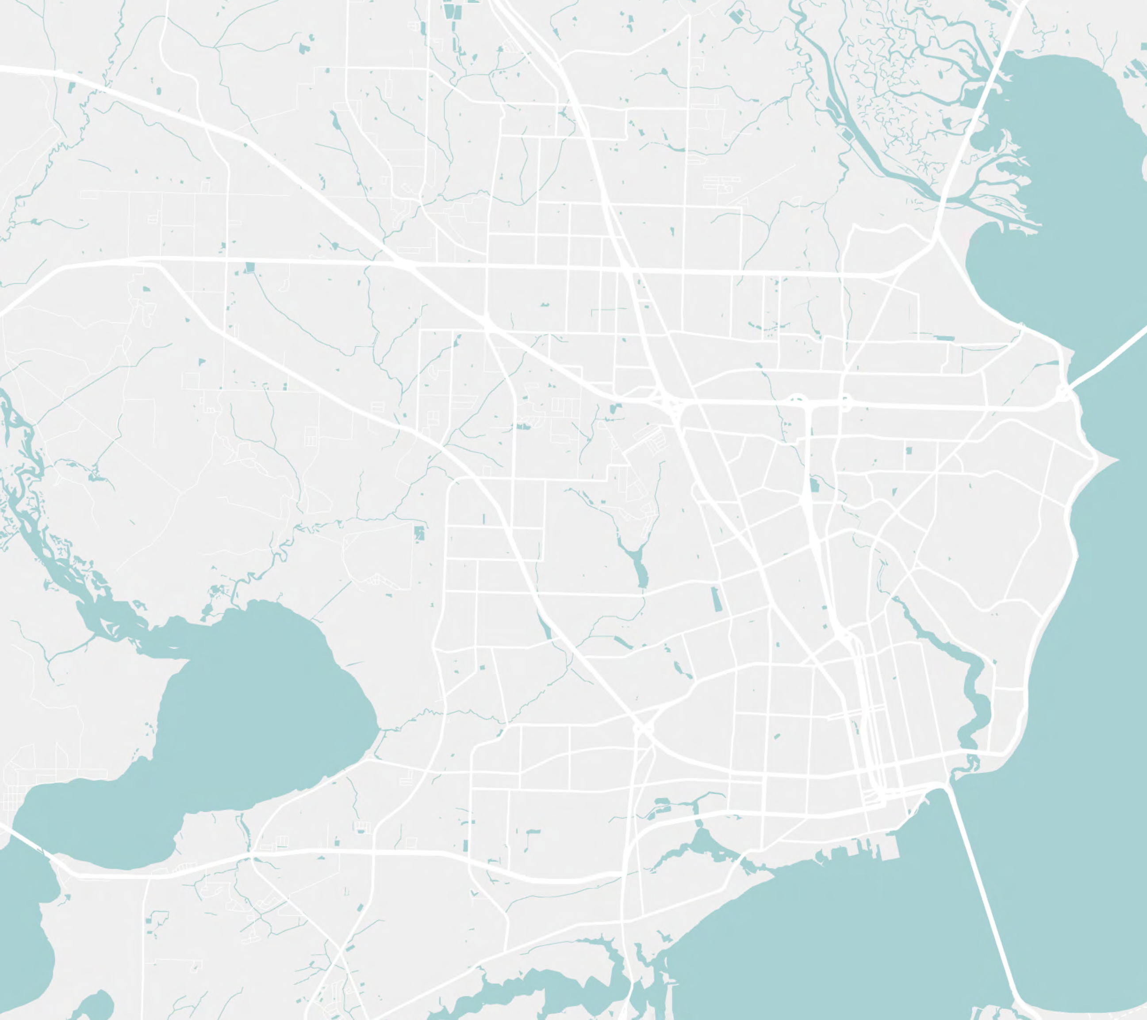
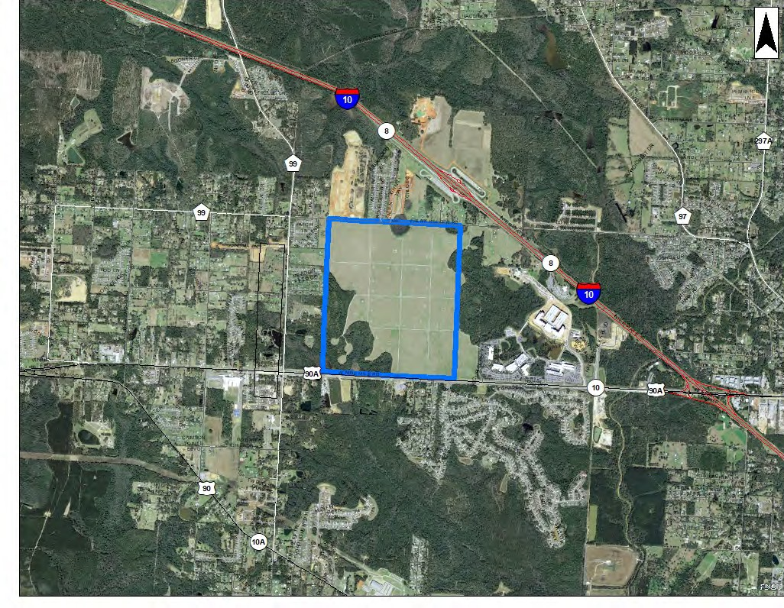


Gonzalez
Pensacola Blvd
Beulah Rd
W 9 Mile Rd
E 9 Mile Rd
Escambia Bay
Ensley
Ferry Pass
Mobile Hwy
Pine Forest Rd
Northeast Pensacola
Brent
Bellview
Pensacola Blvd
Perdido Bay
West Pensacola
W Cervantes St
Pensacola
W Navy Blvd
US Hwy 98
Warrington
Pensacola Bay
Context | Identity | Opportunities | Aspirations | Needs | Limitations | Competitive Edge
Beulah’s Community Character

Slide 6
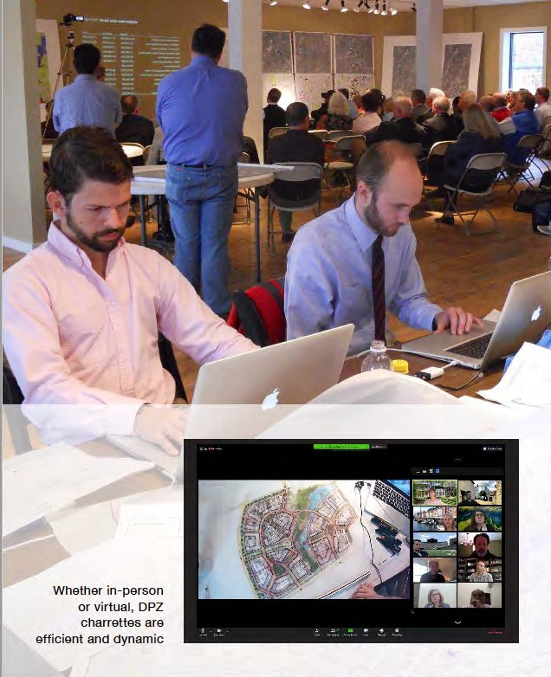
Introduction and COVID-19 impact
Public Engagement Goals
  Educate public about project opportunities;
  Engage widely with citizens and stakeholders in the planning and design process;
  Ensure transparency, engagement and alignment;
  Evaluate public sentiment and quantify feedback on project deliverables.
Engagement Strategy
  Be nimble and flexible based on current conditions;
  Be clear on engagement expectations and rules of engagement;
  Create online digital platform to engage public broadly;
  Be creative with non-digital outreach;
  Maintain momentum throughout project duration and consider remote Charrette
Ongoing Communication and Engagement
  Narrate the process;
  Integrate with other communication and engagement tools;
  Provide multiple ways of engaging & providing ongoing feedback.
Public Engagement

Slide 7
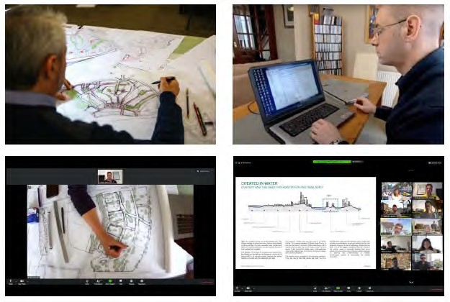
Virtual Charrette may include:
  Virtual and in-person meetings;
  Topical team work sessions;
  Stakeholder interviews;
  Interactive planning and design reviews;
  Live cameras on designers;
  Presentations;
  On-going community online engagement and feedback.
Virtual Charrette

Slide 8
OLF-8 Kick-Off SCHEDULE
Week of: May 20
5/20
5/21
THURSDAY
(CDT)
WEDNESDAY
8:00 AM
8:30 AM
9:00 AM
9:30 AM
10:00 AM | Team Introduction
10:30 AM |  | Topic 3 Meeting {Transportation)
11:00 AM | Review of Scope & Timeline
11:30 AM
12:00 PM | lunch break | lunch break
12:30 PM
1:00 PM | Topic 1 Meeting {Market Analysis) | Topic 4 Meeting. (Public Outreach)
1:30 PM
2:00 PM
2:30 PM | break | break
3:00 PM | Topic 2 Meeting {Environmental & Infrastructure) | Topic 5 Meeting. {Planning, Zoning & Land Use)
3:30 PM
4:00 PM
4:30 PM |  | Wrap-up
5:00 PM
5:30 PM
6:00 PM
6:30 PM
Remote technical kick-off meeting
  Project goals and objectives;
  Project schedule and management protocols’
  Community engagement strategies plan;
  Project history and prior /ongoing planning efforts
  Project site, opportunities and constraints;
  Development program and market demand;
  Zoning and FLU with goal to select entitlement strategy;
  Data collation and existing conditions analysis;
  Schedule first public presentation
+
Summer - Site visit, in person
Next Steps for Phase 1: Kick-Off Meeting

Slide 9
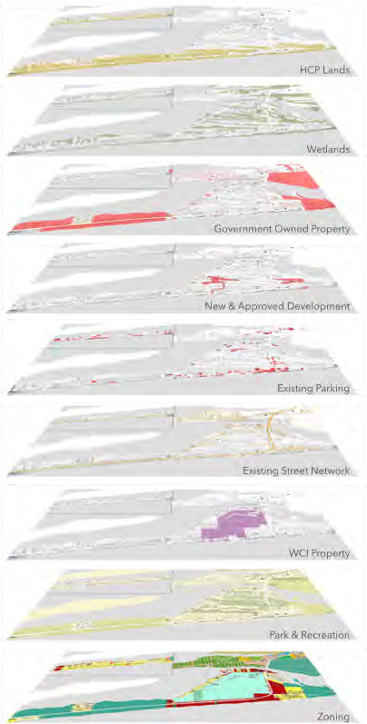
Task 1.2: Existing Conditions |Technical Analyses
  Character, Land Use and Zoning Analysis
  Environmental & Civil Analysis
  Infrastructure Analysis
  Transportation Analysis
Task 1.3: Market & Fiscal Analyses
  Economic Impact Analysis
  Fiscal Health Analysis
Task 1.4: Define Community Engagement Plan
Task 1.4: Provide Urban Diagnostic Report
Task 1.5: County Review and BoC Presentation
Next Steps for Phase 1: May - August

Slide 10
1. Preferences on community engagement strategy
Extent of virtual charrette & online platform
Identification of key stakeholders
Frequency of Board updates
Rezoning timing and strategy
Discussion Items

Slide 11
www.myOLF8.com

